Slide 1
Introduction to University Learning & Teaching
Concept of learning and teaching

Slide 2
"O! this learning, what a thing it is.“ William Shakespeare
Activity – think-pair-share
What is learning?
What is teaching?
4 minutes (1 min for thinking, 2 for discussion and 1 for sharing)
https://www.menti.com/4kxr7pxn5g

Slide 3
Learning
Abbott’s (1994) definition highlights the following:
An active process of relating new meaning to existing meaning, involving the accommodation and assimilation of ideas, skills, thoughts and so on.
The connections between past, present and future. These are not always made in a linear fashion: unlearning and relearning play their part.
A process influenced by the use to which the learning might be put. All our learning might be varied and modified in future situations

Slide 4
It is unfortunate, but true, that some academics teach students without having much formal knowledge of how students learn. Many lecturers know how they learnt/learn best, but do not necessarily consider how their students learn and if the way they teach is predicated on enabling learning to happen. Nor do they necessarily have the concepts to understand, explain and articulate the process they sense is happening in their students.

Slide 5
Learning is about how we perceive and understand the world, about making meaning (Marton and Booth, 1997). But ‘learning’ is not a single thing; it may involve mastering abstract principles, understanding proofs, remembering factual information, acquiring methods, techniques and approaches, recognition, reasoning, debating ideas, or developing behaviour appropriate to specific situations; it is about change.

Slide 6
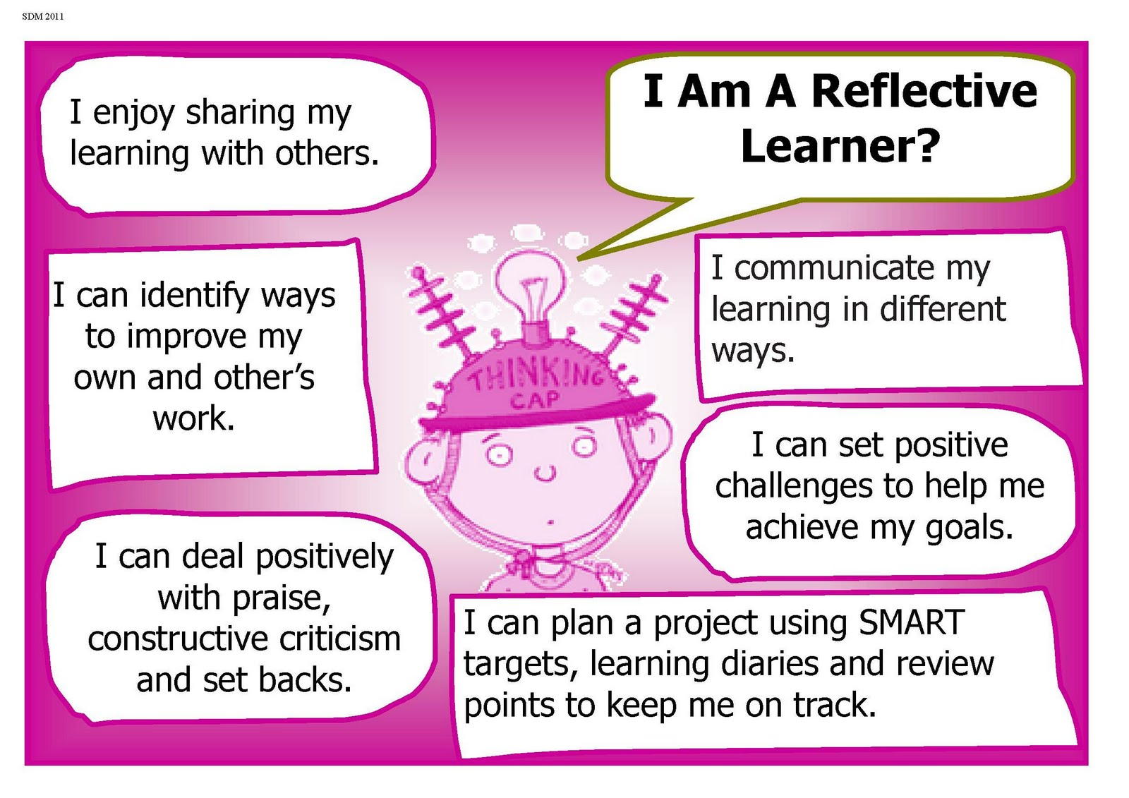

Slide 7
Despite many years of research into learning, it is not easy to translate this knowledge into practical implications for teaching. There are no simple answers to the questions ‘how do we learn?’ and ‘how as teachers can we bring about learning?’ This is partly because education deals with specific purposes and contexts that differ from each other and with students as people, who are diverse in all respects, and ever changing. Not everyone learns in the same way, or equally readily about all types of material. The discipline and level of material to be learnt have an influence. Students bring different backgrounds and expectations to learning
Notes:
Our knowledge about the relationship between teaching and learning is incomplete and the attitudes and actions of both parties affect the outcome, but we do know enough to make some firm statements about types of action that will usually be helpful in enabling learning to happen. I

Slide 8
In psychology there are several schools of thought about how learning takes place, and various categorisations of these. Rationalism (or idealism) is one such school, or pole, of learning theory still with some vogue. It is based on the idea of a biological plan being in existence that unfolds in very determined directions. Chomsky was a foremost member of this pole.
Associationism, a second pole, centres on the idea of forming associations between stimuli and responses. Pavlov and Skinner belong to this pole. Further details may be found in Richardson (1985). In the twenty-first century cognitive and social theories are those used most widely, with constructivism being the best known.

Slide 9
Many ideas about learning in the early twentieth century tended to consider the development of the individual in isolation, but by the 1920s and 1930s ideas looking at the influence of the wider context in which learning occurs and at emotional and social influences and affects became more common. These ideas continue to gain ground.
Some of the learning theories are listed in the next slide.

Slide 10
Learning theories
Cognitive Learning Theory
Behaviorism Learning Theory
Constructivism Learning Theory
Humanism Learning Theory
Connectivism Learning Theory

Slide 11
Activity
After discussing the theories, suggest the teaching strategies or activities that can be used in your classroom.

Slide 12
Now what does teaching mean to you?
Brainstorm

